Slide 1

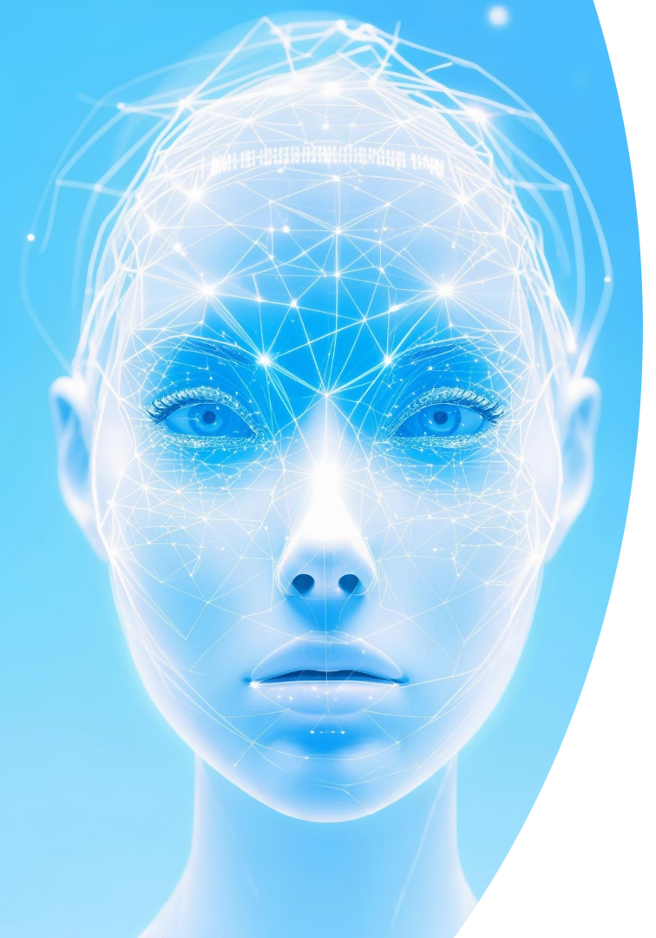
FakeFaceDetector: AI-Powered Detection of Manipulated Facial Images
Detect manipulated facial images instantly with AI. Our web app uses advanced technology for real-time, accurate results. Easy access anywhere, anytime.
Notes:
1

Slide 2
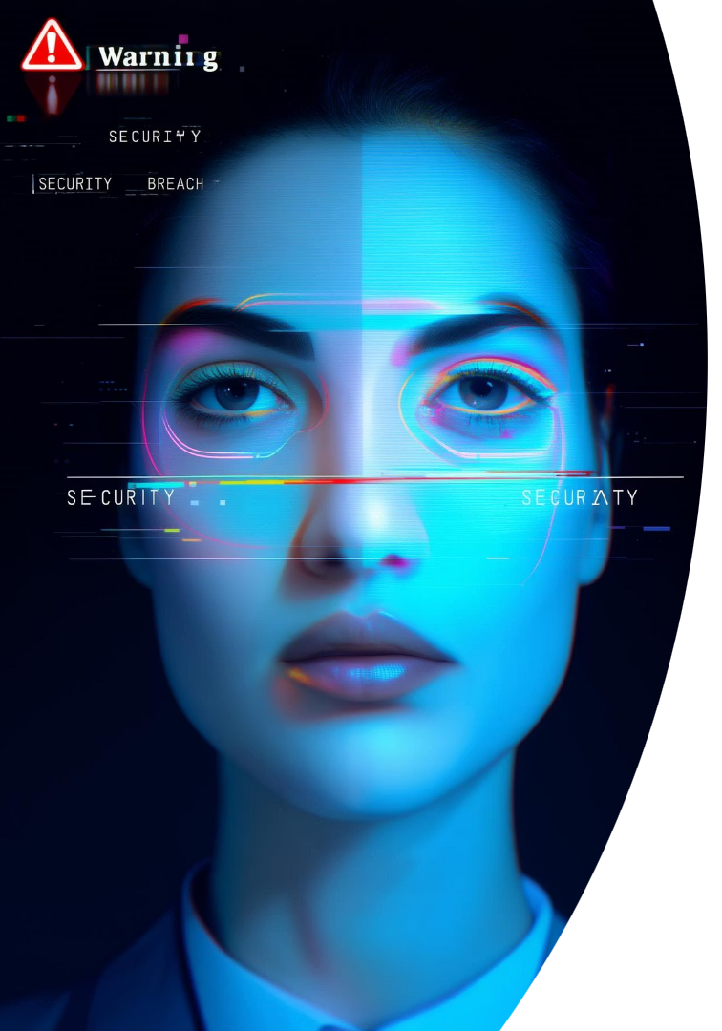
The Growing Threat of Deepfakes
What Are Deepfakes?
Risks of Misuse
Synthetic media that convincingly alters human faces.
Used for disinformation, fraud, and identity theft worldwide.
Detection Market
Expected to reach $3.8B by 2028 due to rising threats.
Notes:
2

Slide 3

Introducing FakeFaceDetector
Purpose
Technology
Combats the rise of manipulated facial images efficiently.
Uses cutting-edge LSTM neural networks for detection.
Performance
Delivers accurate, rapid analysis for multiple industries.
Notes:
3

Slide 4
Core Technology: LSTM Neural Networks
LSTM Strengths
Training Data
Accuracy
Handles sequential data effectively
Trained on over 1 million real and fake images
Achieves over 95% precision in image classification.
Remembers long-term patterns
Detects subtle manipulation traces
Notes:
4

Slide 5




Real-Time Analysis
Speed
Scalability
Efficiency
Processes images within 500 milliseconds on average.
Handles high volumes with optimized infrastructure.
Operates smoothly on standard hardware setups.
Notes:
5

Slide 6

User-Friendly Interface
Drag-and-Drop Upload
Effortless image submission for any user.
Clear Results
Displays straightforward "Real" or "Fake" labels.
Intuitive Design
Accessible for technical and non-technical users alike.
Notes:
6

Slide 7






Comprehensive History Tracking
Review & Trends
Users track past analyses for insights and patterns.
Detailed Logs
Secure Storage
Stores all image submissions and analysis results.
Protects metadata and classification data securely.
Notes:
7

Slide 8
Practical Applications
Social Media
Law Enforcement
Journalism
Identity Verification
Flags deepfake profiles promptly to protect users.
Authenticates evidence for legal accuracy.
Verifies integrity of visual content before publication.
Prevents fraud by detecting fake facial images effectively.
Notes:
8

Slide 9
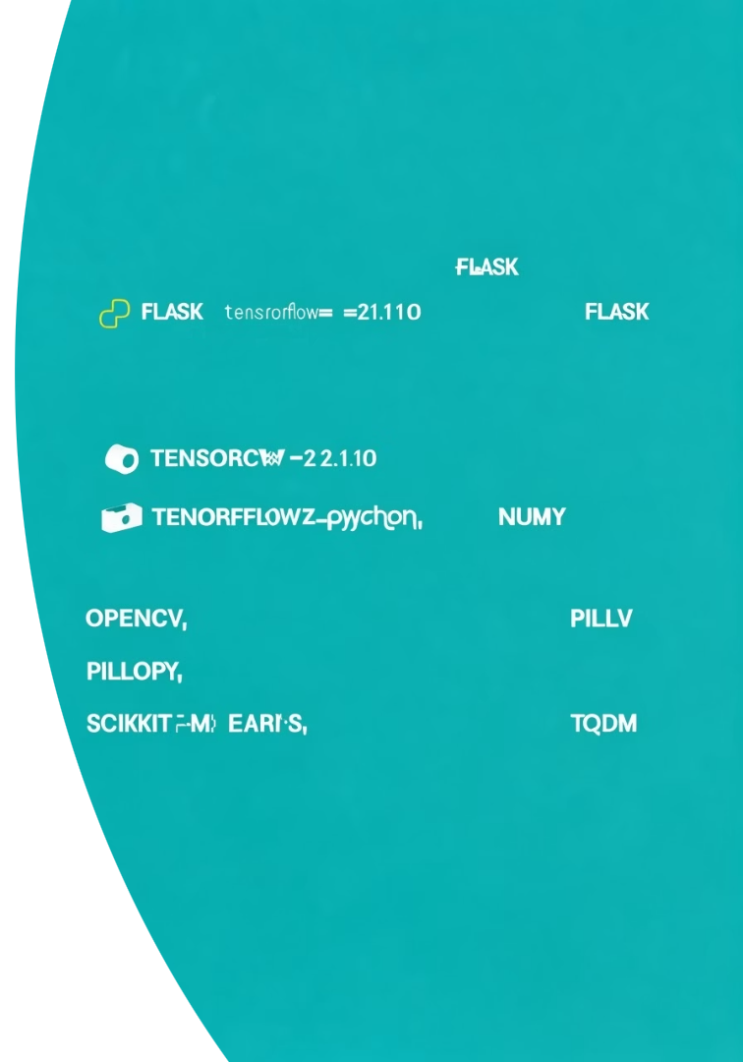
Competitive Advantages
Superior Accuracy
5–10% improvement over existing detection solutions.
Fast Processing
Real-time results with optimized speed and efficiency.
User Friendly
Interface designed to maximize ease of adoption.
Continuous R&D
Innovation keeps ahead of evolving deepfake techniques.
Notes:
9

Slide 10





The Future of FakeFaceDetector
Machine Learning Growth
Constant improvements through enriched data and algorithms.
Video & Audio
Expanding detection to include multimedia manipulations.
System Integration
Seamless connections with security and authentication tools.
Building Trust
Creating a safer, more reliable digital world.
Notes:
10

Slide 11
🌟 Thank You!

